Slide 1
IPv4 & IPv6
Coexistence & Migration
Joe Zhao
SW2
Great China R&D Center
ZyXEL Communications, Inc

Slide 2
Outline
Overview
IPv6 over IPv4
IPv6 to IPv4
ISATAP
Q & A

Slide 3
Overview
Node Term
  IPv4-only node
  IPv6-only node
  IPv4/IPv6 node
    Dual stack support
    Linux & Windows family
  IPv4 node
    IPv4-only or IPv4/IPv6
  IPv6 node
    IPv6-only or IPv4/IPv6

Slide 4
Overview
IPv6 Address For Coexistence
  IPv4-compatible address
    ::w.x.y.z
    used by IPv6/IPv4 nodes, communicating with IPv6 over an IPv4 infrastructure
  IPv4-mapped address
    ::FFFF:w.x.y.z
    used to represent an IPv4-only node to an IPv6 node(internal representation)
  6over4 address
    ::wwxx:yyzz (colon hexadecimal representation of w.x.y.z)
    131.107.4.92 FE80::836B:45C

Slide 5
Overview
IPv6 Address For Coexistence
  6to4 address
    2002: wwxx:yyzz ::/48 (wwxx:yyzz is the colon hexadecimal representation of w.x.y.z, a public IPv4 address)
  ISTAP address
    ::0:5EFE:w.x.y.z
      0:5EFE, OUI
      Type, embedded IPv4 address (FE)
      w.x.y.z, any unicast IPv4 address (public & private)
    FE80::5EFE:131.107.4.92
Notes:
Organizational Unit Identifier (OUI)
Assigned by the Internet Assigned Numbers Authority (IANA)

Slide 6
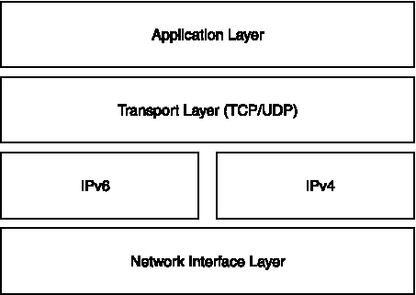
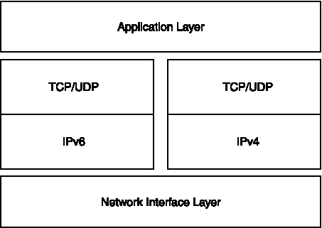
Overview
Coexistence Mechanism
    Dual IP layer

Slide 7
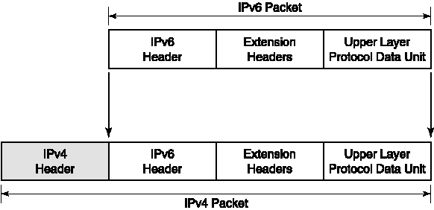
Overview
Coexistence Mechanism
    IPv6 over IPv4 tunneling
      IPv4 Protocol field is set to 41 (IPv6 packet)
      Source and Destination fields are set to IPv4 addresses of the tunnel endpoints
      Manually configured or automatically derived from the sending interface, the next-hop address of the matching route, or the source and destination IPv6 addresses in the IPv6 header

Slide 8
Overview
Coexistence Mechanism
  IPv6 over IPv4 tunneling
    Configured
      Manual configuration of the tunnel endpoints
      Addresses of tunnel endpoints are not encoded in the IPv6 source or destination addresses, nor in the next-hop address of the matching route.
      Typically, router-to-router and host-to-router are configured manually
    Automatic

Slide 9
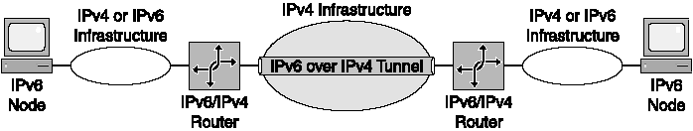
Overview
Coexistence Mechanism
  IPv6 over IPv4 tunneling
    Router-to-router

Slide 10
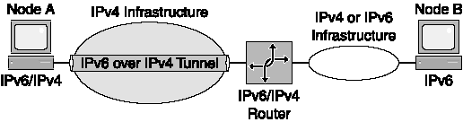
Overview
Coexistence Mechanism
  IPv6 over IPv4 tunneling
    Host-to-router and router-to-host

Slide 11
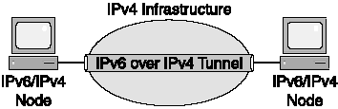
Overview
Coexistence Mechanism
  IPv6 over IPv4 tunneling
    Host-to-host

Slide 12
Overview
Coexistence Mechanism
    DNS infrastructure
      Upgrading the DNS infrastructure consists of populating the DNS servers with AAAA and PTR records to support IPv6 name-to-address and address-to-name resolutions
      Address Records
        A records for IPv4-only and IPv6/IPv4 nodes
        AAAA records for IPv6-only and IPv6/IPv4 nodes
      Pointer Records
        PTR records in the IN-ADDR.ARPA domain for IPv4-only and IPv6/IPv4 nodes
        PTR records in the IP6.INT domain for IPv6-only and IPv6/IPv4 nodes
      Address Selection Rules (Not decided yet)

Slide 13
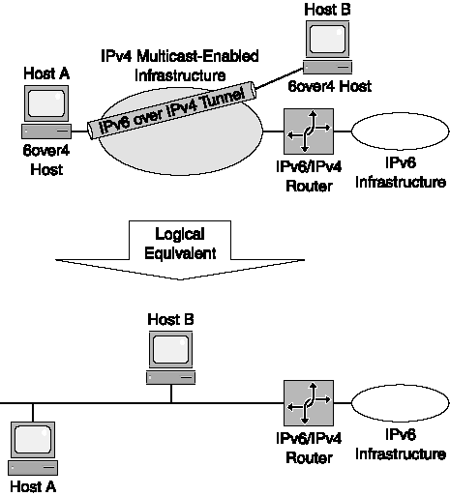
IPv6 over IPv4

Slide 14
IPv6 Over IPv4
6over4 Mechanism
  Lie on IPv4 multicast capability
    Mapping IPv6 multicast address to IPv4 multicast address ( 239.192.[second to last byte of IPv6 address].[last byte of IPv6 address] )
      FF02::1 (link-local scope all-nodes multicast address) is mapped to 239.192.0.1
      FF02::2 (link-local scope all-routers multicast address) is mapped to 239.192.0.2
      FF02::1:FF28:9C5A (example solicited-node multicast address) is mapped to 239.192.156.90

Slide 15
IPv6 Over IPv4
6over4 Mechanism
  IPv4 layer uses IGMP messages to inform local IPv4 routers of its interesting IPv4 multicast traffic
  Register additional multicast MAC addresses
    The corresponding multicast MAC address for 239.192.0.1 is 01-00-5E-40-00-01.
    The corresponding multicast MAC address for 239.192.0.2 is 01-00-5E-40-00-02.
    The corresponding multicast MAC address for 239.192.156.90 is 01-00-5E-40-9C-5A.

Slide 16
IPv6 Over IPv4
6over4 Sample
  Host A
    IPv4 address of 157.60.91.123
    FE80::9D3C:5B7B
  Host B
    IPv4 address of 131.107.210.49
    FE80::836B:D231
Field | Value
IPv6 Source Address | FE80::9D3C:5B7B
IPv6 Destination Address | FE80::836B:D231
IPv4 Source Address | 157.60.91.123
IPv4 Destination Address | 131.107.210.49

Slide 17
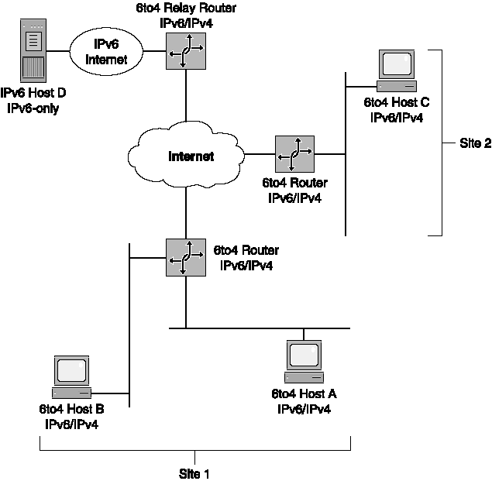
IPv6 to IPv4

Slide 18
IPv6 to IPv4
6to4 Term
  6to4 host
    Any IPv6 host that is configured with at least one 6to4 address
  6to4 router
    An IPv6/IPv4 router that supports the use of a 6to4 tunnel interface
    Forward 6to4-addressed traffic between the 6to4 hosts within a site and other 6to4 routers or 6to4 relay routers on an IPv4 network
  6to4 relay router
    An IPv6/IPv4 router that forwards 6to4-addressed traffic between 6to4 routers on the Internet and hosts on the IPv6 Internet.

Slide 19
IPv6 Over IPv4
6to4 sample
  Host A
    IPv4 address of 157.60.91.123
    2002:9D3C:5B7B:1:[ID_A]
  Host B
    IPv4 address of 131.107.210.49
    2002:836B:D231:2:[ID_C]
Field | Value
IPv6 Source Address | 2002:9D3C:5B7B:1:[ID_A]
IPv6 Destination Address | 2002:836B:D231:2:[ID_C]
IPv4 Source Address | 157.60.91.123
IPv4 Destination Address | 131.107.210.49

Slide 20
ISATAP
ISATAP Overview
  ISATAP is an address assignment for host-to-host, host-to-router, and router-to-host automatic tunneling technology
  Provide unicast IPv6 connectivity between IPv6 hosts across an IPv4 intranet
  Communication between IPv6/IPv4 nodes on an IPv4 network. ISATAP addresses identification ::0:5EFE:w.x.y.z
    ISATAP interface identifier can be combined with link-local (FE80::/64), site-local, and global prefixes (including 6to4 prefixes)

Slide 21
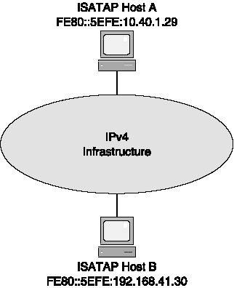
ISATAP

Slide 22
ISATAP
ISATAP sample
  Host A
    IPv4 address of 10.40.1.29
    FE80::5EFE:10.40.1.29
  Host B
    IPv4 address of 192.168.41.30
    FE80::5EFE:192.168.41.30
Field | Value
IPv6 Source Address | FE80::5EFE:10.40.1.29
IPv6 Destination Address | FE80::5EFE:192.168.41.30
IPv4 Source Address | 10.40.1.29
IPv4 Destination Address | 192.168.41.30

Slide 23
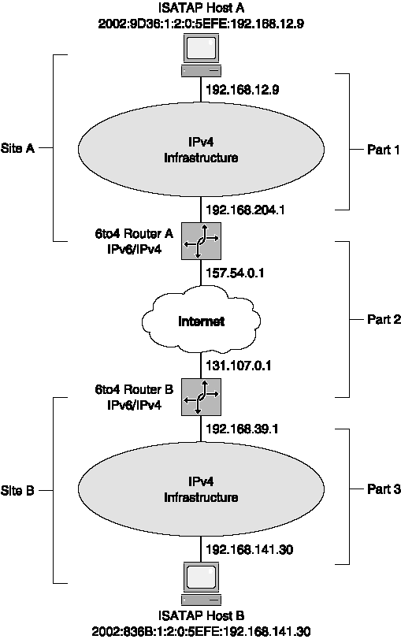
ISATAP

Slide 24
ISATAP
ISATAP sample (Host A communicate with Host B)
  Host A
    IPv4 address of 192.168.12.9
    FE80::5EFE:192.168.12.9 & 2002:9D36:1:2:0:5EFE:192.168.12.9
  Router A
    157.54.0.1 & 192.168.204.1
    FE80::5EFE:192.168.204.1 & FE80::5EFE:157.54.0.1
    2002:9D36:1:2::/64
  Host B
    IPv4 address of 192.168.41.30
    FE80::5EFE:192.168.141.30 & 2002:836B:1:2:0:5EFE:192.168.141.30
  Router B
    131.107.0.1 & 192.168.39.1
    FE80::5EFE:192.168.39.1 & FE80::5EFE:131.107.0.1
    2002:836B:1:2::/64

Slide 25
ISATAP
ISATAP sample (Host A communicate with Host B)
  Host A to 6to4 Router A
Field | Value
IPv6 Source Address | 2002:9D36:1:2:0:5EFE:192.168.12.9
IPv6 Destination Address | 2002:836B:1:2:0:5EFE:192.168.141.30
IPv4 Source Address | 192.168.12.9
IPv4 Destination Address | 192.168.204.1

Slide 26
ISATAP
ISATAP sample (Host A communicate with Host B)
  6to4 Router A to 6to4 Router B
Field | Value
IPv6 Source Address | 2002:9D36:1:2:0:5EFE:192.168.12.9
IPv6 Destination Address | 2002:836B:1:2:0:5EFE:192.168.141.30
IPv4 Source Address | 157.54.0.1
IPv4 Destination Address | 131.107.0.1

Slide 27
ISATAP
ISATAP sample (Host A communicate with Host B)
  6to4 Router B to ISATAP Host B
Field | Value
IPv6 Source Address | 2002:9D36:1:2:0:5EFE:192.168.12.9
IPv6 Destination Address | 2002:836B:1:2:0:5EFE:192.168.141.30
IPv4 Source Address | 192.168.39.1
IPv4 Destination Address | 192.168.141.30

Slide 28
Training course arrangement
Date
Subject
Lecturer
03/10
Introduction to IPv6
Joe Zhao
03/16
IPv6 Addressing
Milo Liu
03/23
IPv6 Header & Extensions
Joe Zhao
03/27
ICMPv6
Feng Zhou
03/30
Neighbor Discovery Protocol
Billy Bian
04/06
Multicast Listener Discovery
Jeffrey Zhou
04/07
Address Autoconfigurator
Feng Zhou
04/13
IPv6 Routing
Milo Liu

Slide 29
Training course arrangement
Date
Subject
Lecturer
04/20
IPv6 Migration Mechanisms
Joe Zhao
04/27
IPv6 Mobility
Milo Liu
Setting Up an IPv6 Test Lab

Slide 30
Q & A

